Slide 1
Creating the Server-Side Scripts
Week 06.

Slide 2
Objectives
Demonstrate how to run sql script in workbench
Demonstrate how to connect to database server using Node.js;
Demonstrate how to execute SQL commands in Node.js;
Demonstrate how to route HTTP requests in Node.js.

Slide 3
Tools Required
XAMPP – MySQL
MySQL Workbench
Visual Studio Code
Chrome Browser
Postman

Slide 4
Running SQL SCRIPT

Slide 5
Inserting The Data
Now it is time to populate the Movie Review DB.
Drop any existing movie_review DB
Download the sql file from your LMS Week 6 folder and open them in MySQL Workbench using Open SQL Script….
movie_review.sql
Then execute the lightning icon. If successful, check the data in the movies table and comments table
Watch the Week 6 demo video here

Slide 6
Connecting to Database in Node.js

Slide 7
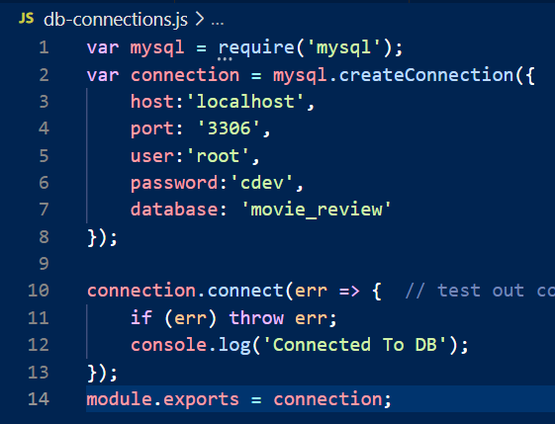
Connection Settings
Run npm init in the terminal to create a js project
In the root folder of project, create a file called db-connections.js.
Check your codes against the codes on the right in db-connections.js.
If everything is same as the one on the right, proceed to the next slide.

Slide 8
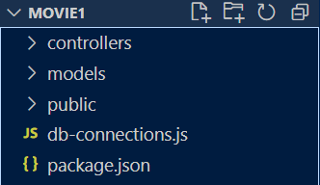
Creating MovieDB.js
Create the following folders
You will now learn to write the SQL codes in JavaScript to access the database.
Under the models folder, create a new file called MoviesDB.js.

Slide 9

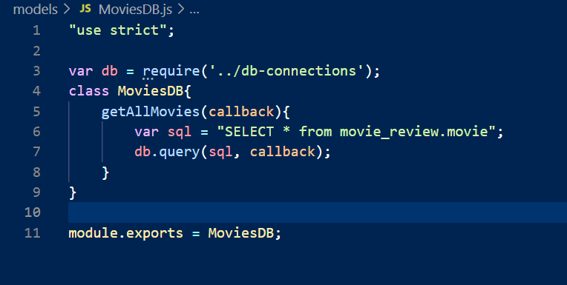
Creating MovieDB.js
In the MoviesDB.js file, add the codes shown below.

Slide 10
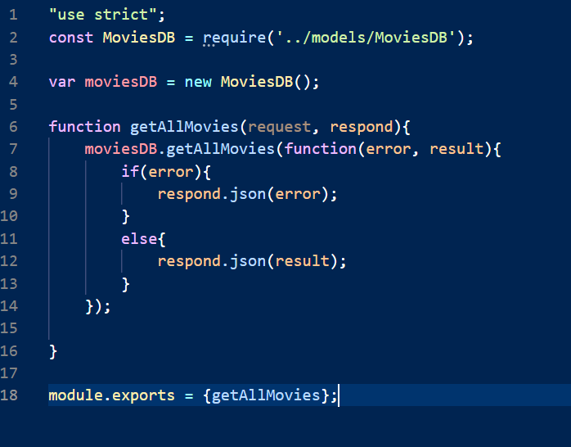

Creating movieController.js
Under the controllers folder, create a new file called movieController.js.

Slide 11
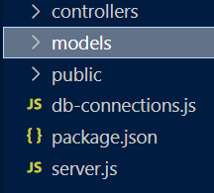
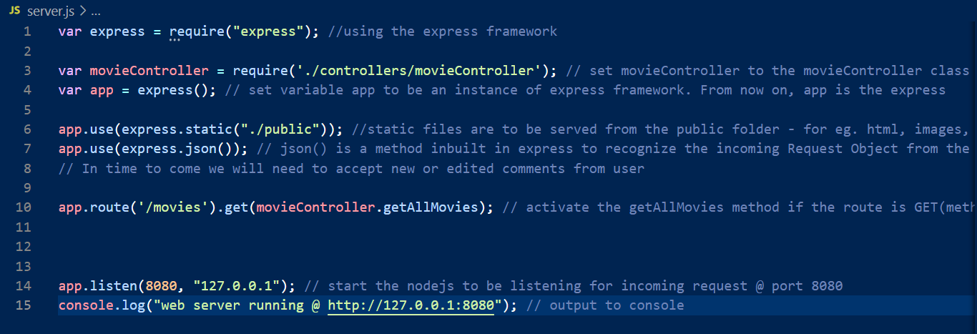
Creating the main file - server.js
Next, open your server.js file to edit.
Add the highlighted codes as shown here.
Here, the URL is ‘/movies’ and the GET method

Slide 12
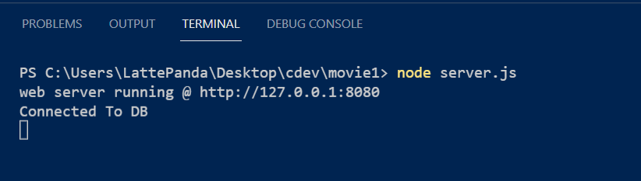
Run the main file - server.js
Next, open terminal and install mysql and express
npm install mysql (observe the package.json)
npm install express (observe the package.json)
And you are ready to run server.js
node server.js

Slide 13
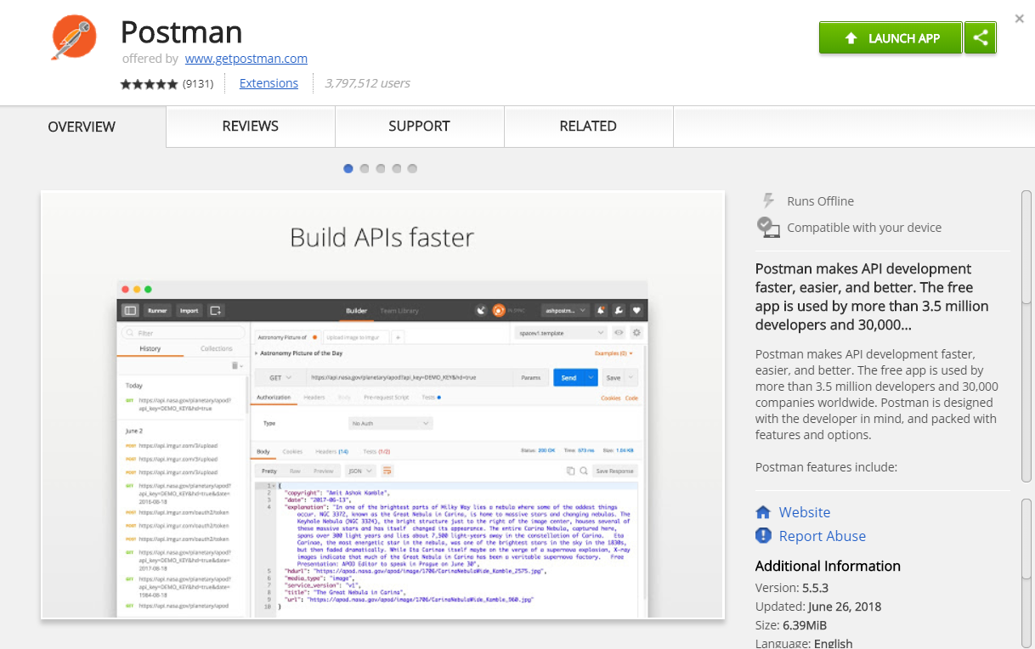
Test it!
Download and install the “Postman” app for Google Chrome

Slide 14
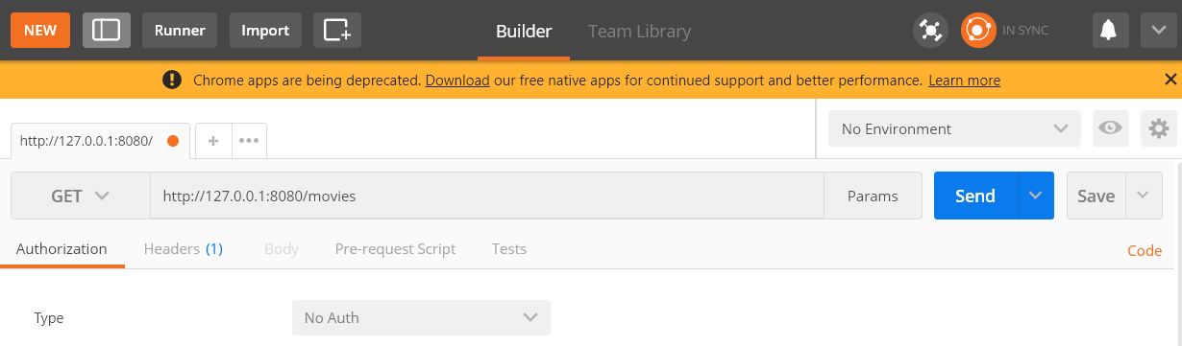
Test it!
Launch the Postman app in your browser
Select the “GET” function and paste the URL http://127.0.0.1:8080/movies to test if the API that we have created to retrieve movies is working correctly (remember to start your SQL server in XAMPP)
For GET operation, you can also test with your browser
Click on the “Send” button

Slide 15
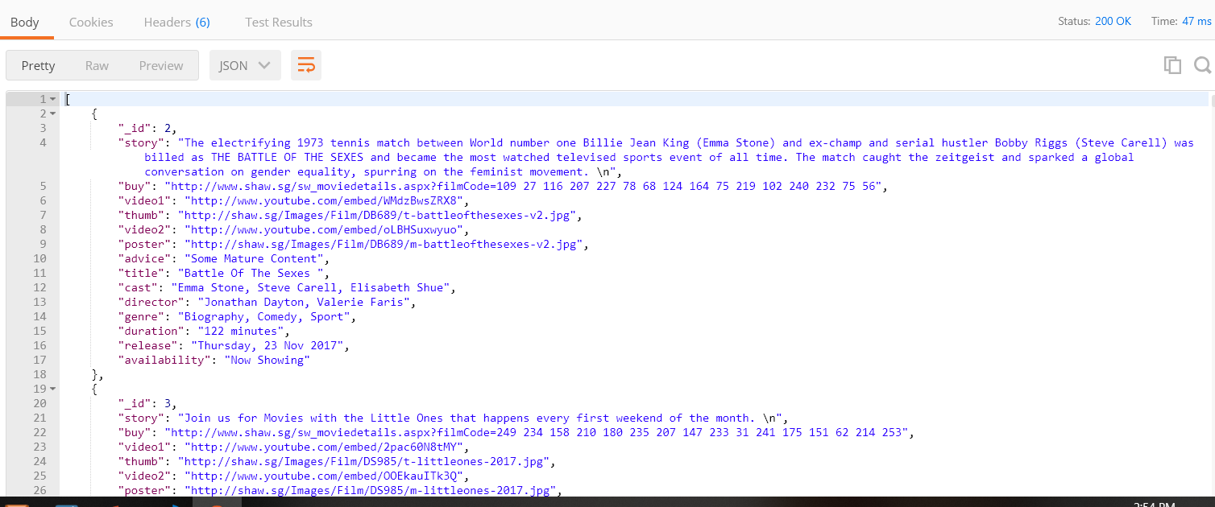
Test it!
You should see the following data in JSON format in the “Body” of the Postman app
When the retrieval of data is successful, you should see a status “200”

Slide 16
Next Episode
In the next episode, you will learn how to create APIs to view, create, update, and delete comment.

Slide 17
Reference
TutorialsPoint – Learn MySQL
https://www.tutorialspoint.com/mysql/index.htm
W3Schools – Node.js MySQL Select From
https://www.w3schools.com/nodejs/nodejs_mysql_select.asp

Slide 18
The End

